Slide 1

ExtJS 4
Dima Ionut Daniel

Slide 2
Contents
What is ExtJS 4?
History
Distribution
Architecture
Basics
Core Concepts
Components
Data Management
Forms
Grid Panel
Conclussion
Bibliography

Slide 3

What is ExtJs 4?
Ext JS is a pure JavaScript application framework for building interactive web applications.
ExtJS uses techniques such as Ajax, DHTML and DOM scripting.
Originally built as an add-on library extension of YUI by Jack Slocum, Ext JS includes interoperability with jQuery and Prototype.
Beginning with version 1.1, Ext JS retains no dependencies on external libraries, instead making their use optional.

Slide 4
History
Ext JS version 2.0 was released on 4 December 2007; it didn't provide a backward compatibility with version 1.1.
Ext JS version 3.0 was released on 6 July 2009; it added communication support for REST and a new Ext and was backwards compatible with version 2.0 code.
Ext JS version 4.0 was released on April 26th, 2011; new support for SVG, VML, charting, MVC were added.
On 15 June 2010, the merge of Ext JS with JQTouch and Raphaël formed Sencha Inc.
Sencha products:
Sencha Touch
Sencha GWT (now Sencha GXT
Sencha Architect
Sencha Animator
Ext core

Slide 5
Distribution
Ext JS 4 distribution contains several directories:
build: used for creating custom version of Ext JS library.
docs: contains documentation of the API
examples: contains a lot of examples of the components,etc
Locale: contains translations of 45 languages
src: contains classes of the framework.
resources: css styles and images
welcome: styles and image
ext-all.js: complete library with all the components, utilities, and classes.
ext-all-debug.js: same as the ext-all.js file, but it is not minified so we can use this file to debug the application.
ext-all-dev.js: similar to the ext-all-debug.js file but contains additional code to show more specific errors and warnings at development time;
ext.js: core and foundation layer for Ext JS.

Slide 6
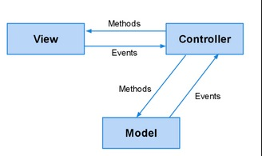
Architecture
ExtJs uses MVC (Model-View-Controller) pattern.
The model layer is intended to define our domain objects.
The view layer allows us to display the data. Ext contains many components, layouts, and widgets that we can use in order to show our data.
The controller layer will serve as an observer.

Slide 7
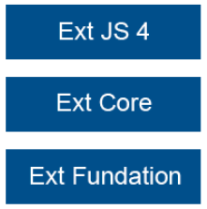
Basics
ExtJS 4 allows to create cross-browser applications with a powerful set of components and widgets.
Ext JS 4 came out with a great tool to create themes and templates in a very simple way.
The framework for creating the themes is built on top of Compass and Sass.
Ext JS is divided in three layers.
Ext Foundation layer: objects are created, utilities.
Ext Core: manages DOM, fire events, Ajax support.
Ext JS 4: widgets, components, etc.

Slide 8
Basics (cont.)
Before we can start creating widgets we need to wait until the DOM is ready to be used.
Ext JS provides a function called Ext.onReady, which executes a callback automatically when all nodes in the tree can be accessed.
Ext.onReady(function(){
alert(“Ready…");
});
Using Ext.Msg we can create following messages:
Alerts: Ext.Msg.alert("Confirmation title","Done testing!");
Confirmation: Ext.Msg.confirm("Confirm","Do you like Ext JS?",function(btn){…});
Prompt: Ext.Msg.prompt('Name', 'Please enter your name:', function(btn, text){});
progress bar
custom message

Slide 9
Core Concepts
Ext.define: creates new classes.
Ext.create: is an alias for the instantiate method from the class manager.
Ext.widget: calls the instantiateByAlias method to create instances of the given alias.
The Ext JS provides an easy way to deal with the DOM.
ExtJS supports most of the CSS3 selectors specification and the basic XPath.
Ext.Element: gets a node by its ID and then manipulate the node using the Element wrapper.

Slide 10
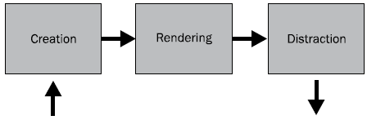
Core Concepts (cont.)
Every widget in the Ext framework extends from the Ext.Component class.
Every component has a lifecycle.
Three phases in the component's lifecycle:
creation process,
rendering process
destruction process.
The Ext.AbstractComponent and Ext.Component classes directs the lifecycle process.

Slide 11
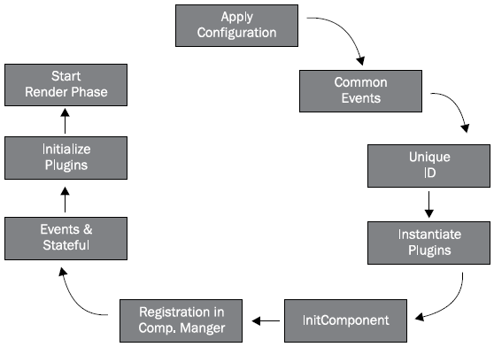
Core Concepts (cont.)
The creation phase
creates the component based on the configuration.
registers the new component on the component manager
define events such as: enable, disable,etc
assigns ID to the instance; if not in the configuration it will be auto-generated.
the plugin will create the instance.
initComponent function is executed

Slide 12
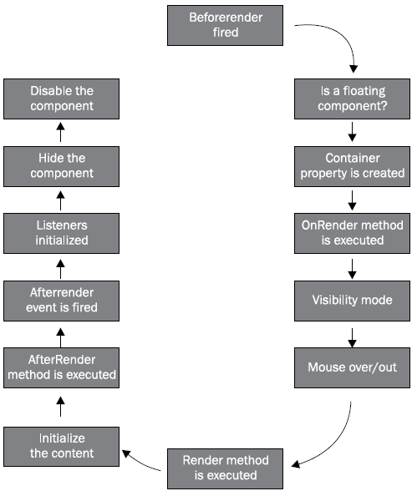
Core Concepts (cont.)
The rendering phase
the required nodes will be inserted to the DOM: syles, listeners

Slide 13
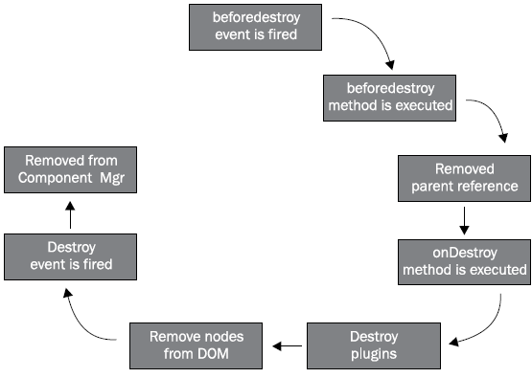
Core Concepts (cont.)
The destruction phase
clean the DOM, remove the listeners
clear the used memory by deleting objects and arrays

Slide 14
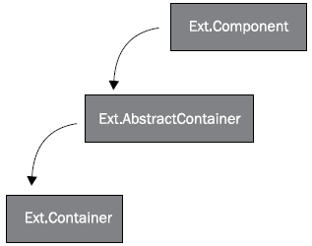
Core Concepts (cont.)
Ext JS has the ability to create complex layouts.
The Ext.container.Container class is responsible to manage children and to arrange those using layouts.

Slide 15
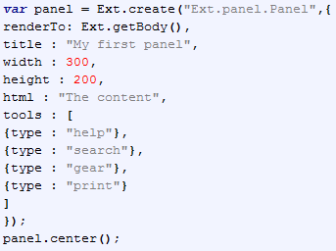
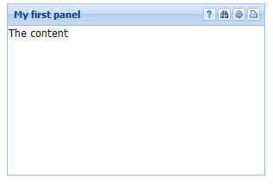
Components
A panel is a container that can be placed as a block in a given space
A panel can contain other panels or even other components.
In order to create a panel we need to instantiate the Ext.panel.Panel class.

Slide 16
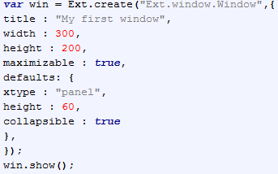
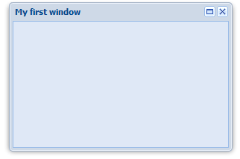
Components (cont.)
A window is basically a floating panel with more features.
The Window component extends from the Panel class.
The maximizable property allows us to maximize the window.
By default, the window is closable, but we can make it unclosable by setting the closable property to false.

Slide 17
Components (cont.)
There are many available layouts we can use to arrange our components, such as accordions, cards, columns, regions, etc.
All available layouts in the Ext.layout.container package.
Fit layout: intended to be used for only one child
Card layout: wizard or display only one component at a time
HBox layout: arrange components horizontally.
VBox layout: arrange components vertically.
Border layout: divides the container space into five regions: north, south, west, east, and center.
Accordion layout: show one component at a time.

Slide 18
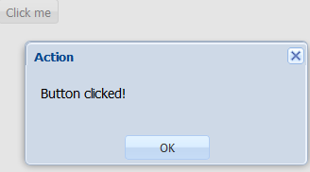
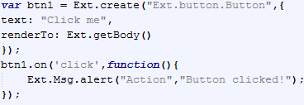
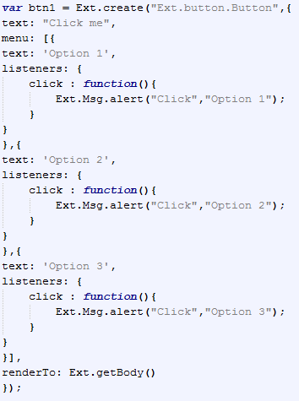
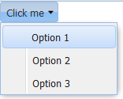
Components (cont.)
The Ext.button.Button class is used to create a button.

Slide 19
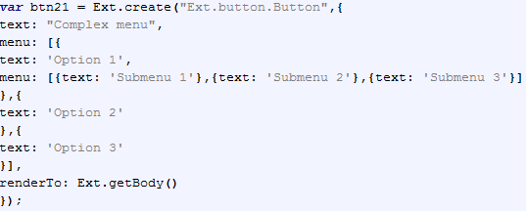
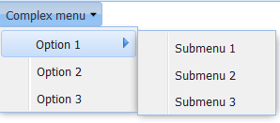
Components (cont.)
Submenus can also be created.

Slide 20
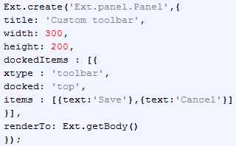
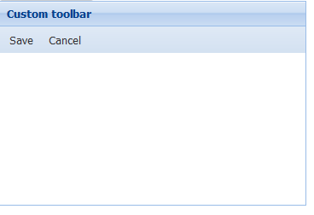
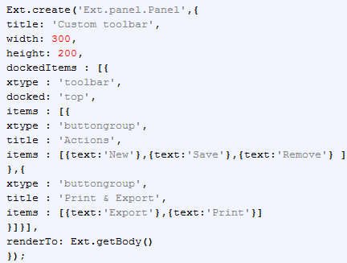
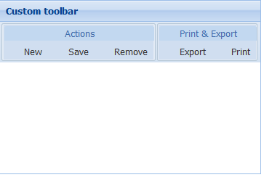
Components (cont.)
Using the Panel class we can create toolbars.

Slide 21
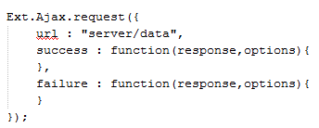
Data Management
Ext JS creates an abstract layer with a lot of classes and configurations;
Ext JS can make Ajax requests to server.
The Ext.data.Connection class is responsible to make asynchronous requests to the server.
Ext JS uses proxies to send and retrieve the data to the source.
Ext JS has three available readers to encode and decode the data: the Array, JSON, and XML readers.

Slide 22
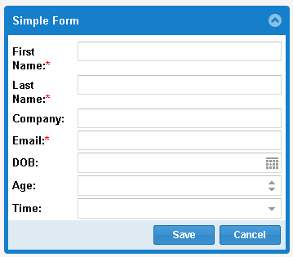
Forms
Ext JS contains form component and many types of input widgets like textfields, textarea, radios, checkbox, combos, sliders, etc.
Ext collects and handles data with the Ext.form.Panel class.

Slide 23
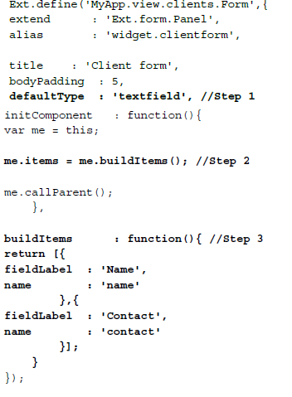
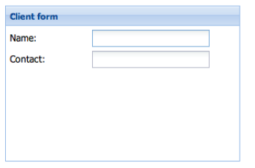
Forms (cont.)
We are using the items property to add components to our form that returns an array of components.
If we want to define new components we can override the xtype property with the component we need.

Slide 24
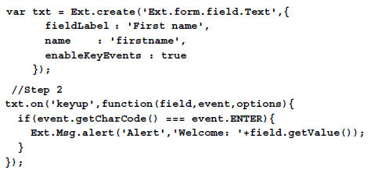
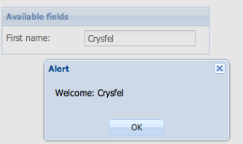
Forms (cont.)
We can create textfields using the Ext.form.field.Text class.
The class extends from the base class and manages text.

Slide 25
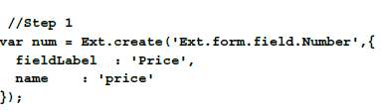
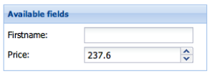
Forms (cont.)
When dealing with numbers we can use the number field that only accepts numbers as a value.

Slide 26
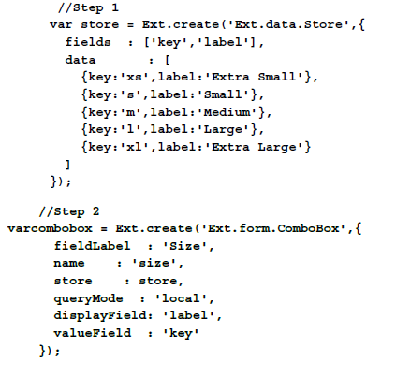
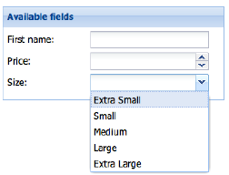
Forms (cont.)
The combobox is one of the most useful widgets to display a list of options.

Slide 27
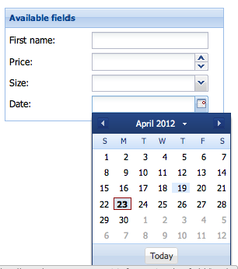

Forms (cont.)
Ext provides an easy way to collect dates, a date picker that will handle the selection of a date

Slide 28
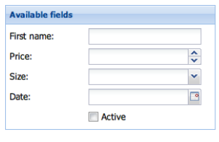
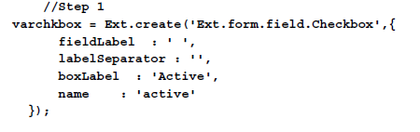
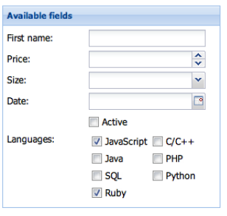
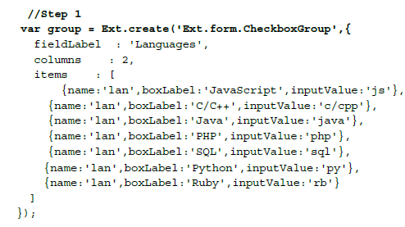
Forms (cont.)
Checkbox is very handy when working with boolean values. We can also use Checkbox group.

Slide 29
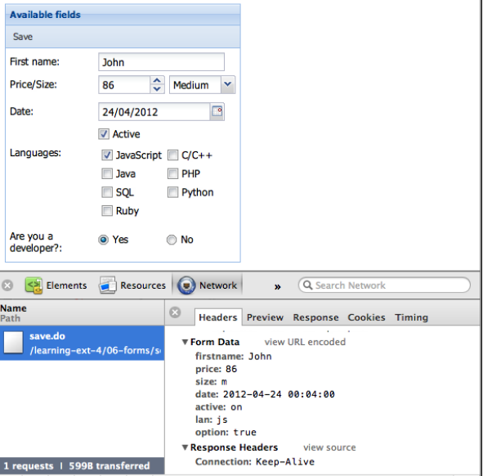
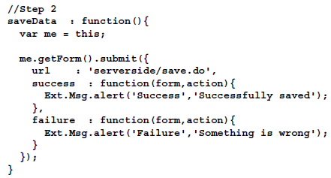
Forms (cont.)
The Ext.form.Panel class contains an instance of the Ext.form.Basic class.
This class is used to manage the data within the form, such as validations, settings and retrieving data to the fields, submitting and loading data from the server, etc.

Slide 30
Grid Panel (cont.)
The grid component is the most used component.
It display, sort, group, and edit data very easily in a very common format.
Grids are excellent for showing large amounts of tabular data.

Slide 31
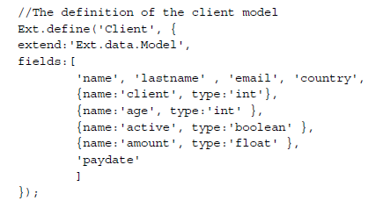
Grid Panel
We created a Client model that extends from Ext.data.Model and has all the properties of our client.

Slide 32
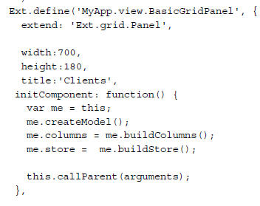
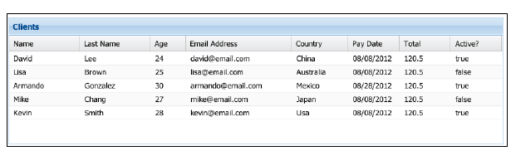
Grid Panel
We can define the grid based on the model and store.

Slide 33
Conclussion
PROS:
The most adopted javascript RIA framework
Good code quality/readability
It has quite good documentation with tutorials, samples and user community.
Amazing set of widgets, does everything we could possibly want.
CONS:
HTML, full of div(s) and overly complex generated code.
Modified GPL 3.0 licensed. Free for open source applications but paid for commercial closed source applications.
Debugging is not very easy.
Need quite experienced developer.

Slide 34

Bibliography
http://en.wikipedia.org/wiki/Ext_JS
Packtpub – Learning Ext JS 4

Slide 35
Questions ?

